Slide 1
Ground to Sky
A Deep Dive into MAVLink

Slide 2
Agenda
1️⃣ Introduction to MAVLink
What it is, why it exists, and its role in UAV communication. Interactive: “Who talks to whom?” activity.
2️⃣ MAVLink Architecture & Message Format
Understand how MAVLink packets are structured and transmitted. Visual: Packet breakdown, message fields, CRC.
3️⃣ Communication Flow in UAV Systems
How GCS, Flight Controller, and Companion Computer exchange data. Diagram: Multi-link MAVLink network.
4️⃣ Hands-On: Sending and Receiving MAVLink Messages
Using pymavlink to monitor telemetry and send commands. Live demo: HEARTBEAT, ATTITUDE, COMMAND_LONG.
5️⃣ Advanced Topics — MAVLink v2 & Security Enhancements
Message signing, CRC extra, custom XML messages. Showcase: Custom message generation demo.

Slide 3
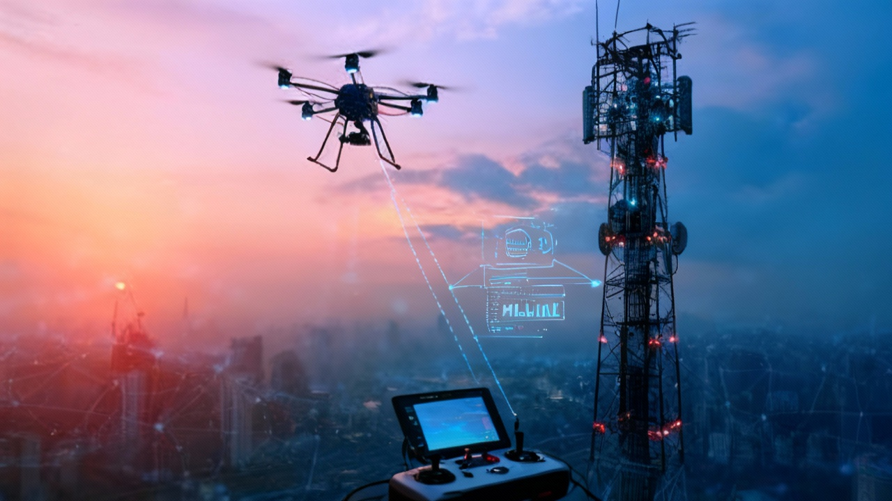
Goal
Understand MAVLink architecture, message flow, and practical implementation for UAVs

Slide 4
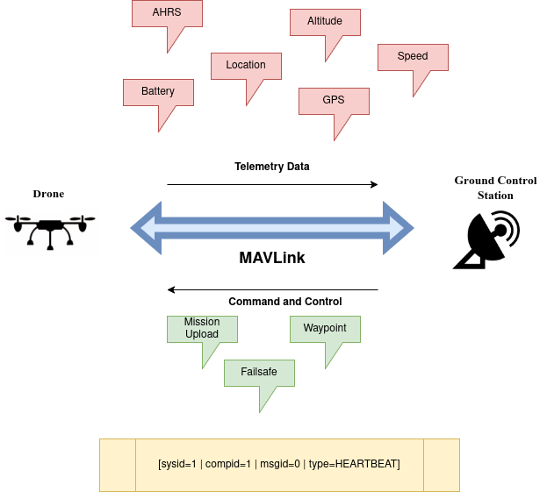
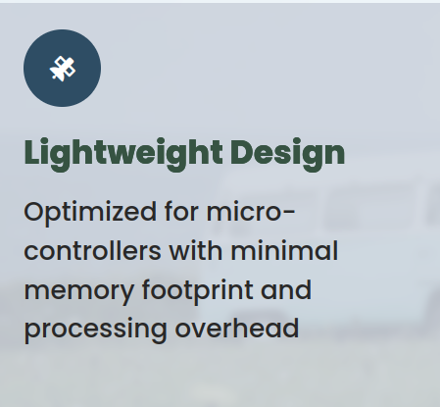
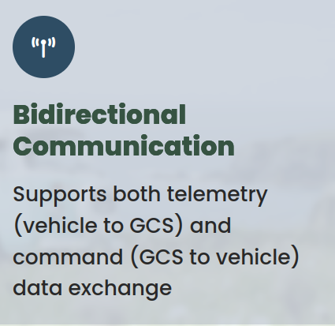
Speaking the Drone’s Language
Understanding How Drones, Ground Stations, and Computers Communicate in the Sky

Slide 5
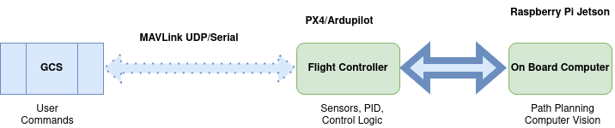
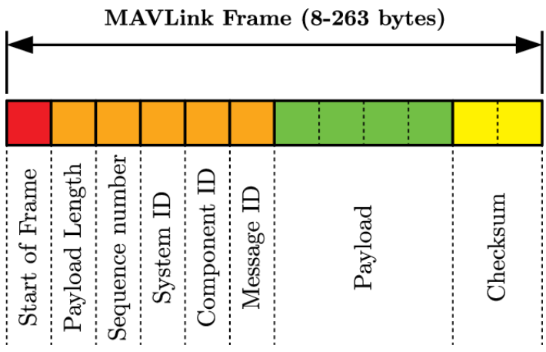
MAVLink Message Format — The Anatomy of a Packet
Imagine you’re running a drone communication network — like a chat system between:
the Ground Control Station (GCS) 🖥️ (like QGroundControl)
the Drone’s Flight Controller 🧠 (like Pixhawk, Cube, etc.)
and sometimes a Companion Computer 🤖 (like Jetson Nano or Raspberry Pi).

Slide 6
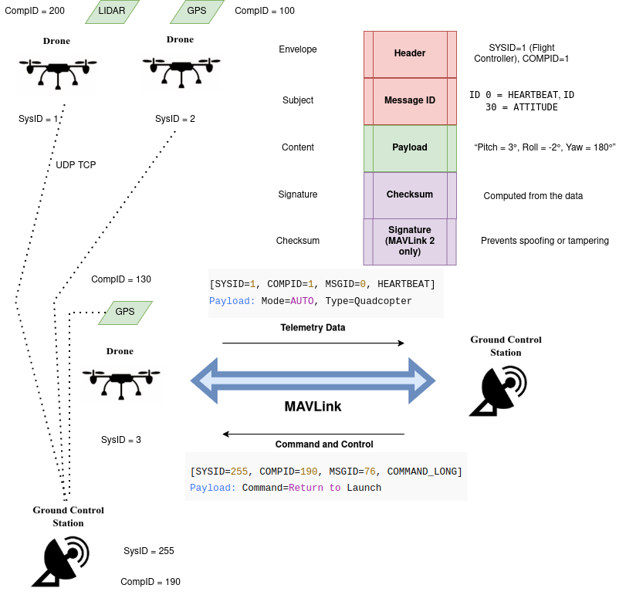
Understanding MAVLink Packet Structure — Simplified Explanation
✅ Example analogy:
Imagine you’re sending a letter to your friend:
The envelope (header) has your name and address.
The subject (message ID) says what the letter is about.
The content (payload) is your actual message.
The signature proves you wrote it.
The checksum ensures it wasn’t changed in transit.

Slide 7
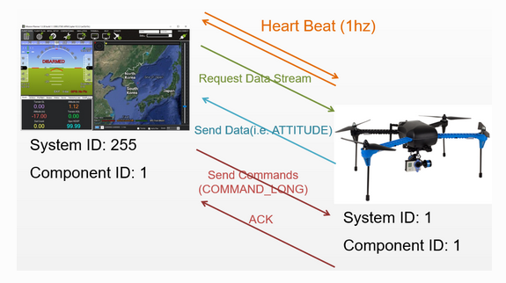
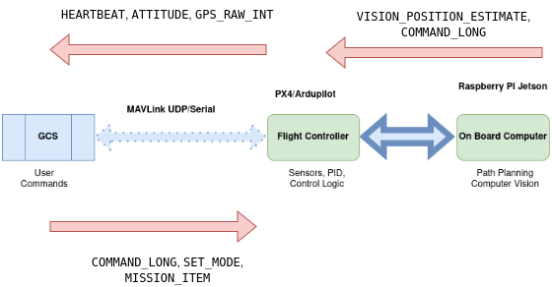
MAVLink Communication Flow
💬 Quick Analogy
“Think of MAVLink as a group chat The Ground Station says ‘Take off!’ The Flight Controller replies ‘Altitude 20m reached!’ The Companion Computer adds ‘Object detected ahead.’ All in the same language — MAVLink.”

Slide 8
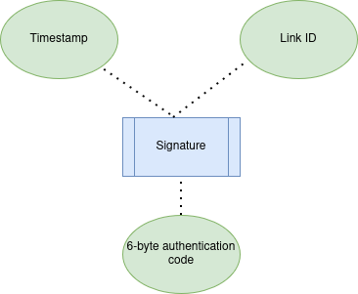
Advanced Concepts — MAVLink 2: Security
🧠 Concept
MAVLink 2 can sign each message with a digital fingerprint — proving it really came from your drone or GCS.
🧱 Purpose:
Prevent spoofing (fake messages)
Stop replay attacks (resending old commands)
Protect command integrity in multi-drone or defense setups

Slide 9
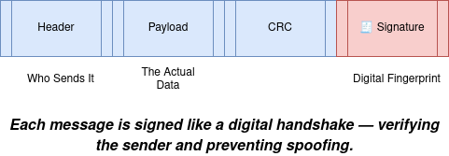
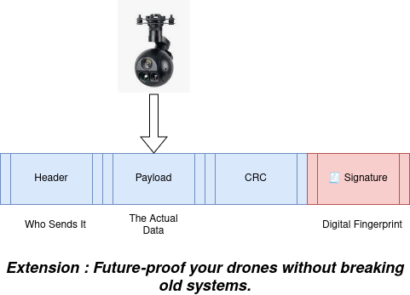
Advanced Concepts — MAVLink 2 Extensions
Feature | MAVLink 1 | MAVLink 2
Message Size | 263 bytes | 280 bytes
Extensions | ❌ | ✅
Message Signing | ❌ | ✅
Backward Compatible | ❌ | ✅
CRC Extra | Basic | Stronger Check

Slide 10
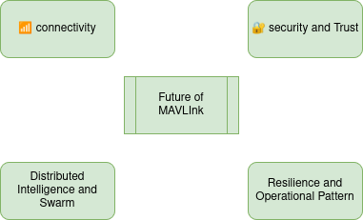
The Future of UAV Communication
MAVLink 2 isn’t just communication — it’s the digital backbone of next-gen UAV networks.
🔮 Trend | What It Means
Encrypted MAVLink | Research for full message encryption (beyond signing)
DroneCAN Integration | MAVLink over CAN for modular avionics
Swarm & AI Extensions | Data sharing between autonomous UAVs
Standardized Extensions | Common fields for industry compatibility

Slide 11
Case Study : How MAVLink 2 powers real-time coordination in next-generation combat UAVs
Collaborative Combat UAV

Slide 12
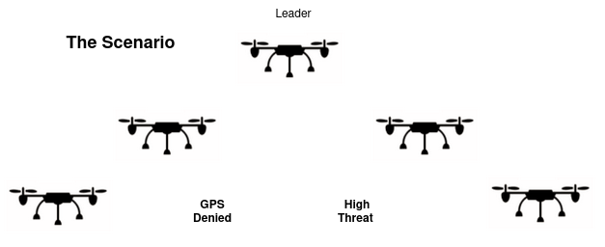
Mission Scenario
Each UAV is both a sensor and a teammate — sharing data, reacting collectively.

Slide 13
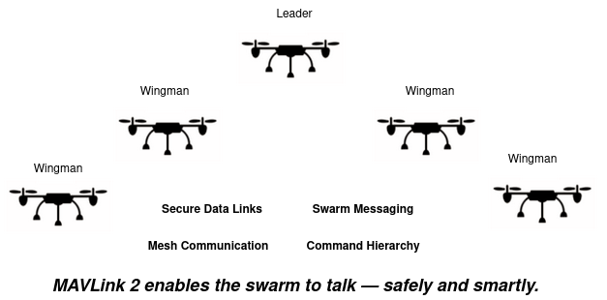
MAVLink 2: The Digital Backbone

Slide 14
Key Technical Highlights
🔐 Security
Message signing ensures command authenticity
CRC checks protect message integrity
📡 Network
Multi-node UDP link with dynamic routing
Fallback to serial or radio if link lost
🧩 Extensibility
Custom CCA_STATUS message (e.g., target vector, threat level,Threat prioritization)
Payload module updates over MAVLink
Capability | Enabled by MAVLink 2
Real-time target sharing | Message broadcasting
Secure coordination | Message signing
Modular payload upgrades | Message extensions
Reduced GCS dependency | Peer-to-peer links

